Slide 1
PRETERM LABOUR
Dr Shanthi Serene Sylum V
Professor and Head
Dept. Obstetrics and Gynaecology
SKHMC Kulasekharam

Slide 2
DEFINITION:
Preterm labor (PTL) is defined as one where the labor starts before the 37th completed week (< 259 days), counting from the first day of the last menstrual period.
The lower limit of gestation is not uniformly defined
In developed countries it has been brought down to 20 weeks
in developing countries it is 28 weeks.
Preterm birth is the significant cause of perinatal morbidity and mortality.

Slide 3
ETIOLOGY
In about 50%, the cause of preterm labor is not known.
Often it is multifactorial.

Slide 4
High risk factors:
(A) History:
Th ere is an increased incidence of preterm labor in cases such as:
(1) Previous history of induced or spontaneous abortion or preterm delivery
(2) Pregnancy following assisted reproductive techniques (ART)
(3) Asymptomatic bacteriuria or recurrent urinary tract infection
(4) Smoking habits
(5) Low socioeconomic and nutritional status
(6) Maternal stress.

Slide 5
High risk factors….
(B) Complications in present pregnancy:
May be due to maternal, fetal or placental factors.
Maternal:
(a) Pregnancy complications: Preeclampsia, antepartum hemorrhage, premature rupture of the membranes, polyhydramnios;
(b) Uterine anomalies: Cervical incompetence, malformation of uterus
(c) Medical and surgical illness: Acute fever, acute pyelonephritis, diarrhea, acute appendicitis, toxoplasmosis and abdominal operation.
Chronic diseases: Hypertension, nephritis, diabetes, decompensated heart lesion, severe anemia, low body mass index (LBMI)
(d) Genital tract infection: Bacterial vaginosis, beta-hemolytic Streptococcus, bacteroides, chlamydia and mycoplasma.
Fetal: Multiple pregnancy, congenital malformations and intrauterine death.
Placental: Infarction, thrombosis, placenta previa or abruption.

Slide 6
High risk factors….
(C) Iatrogenic: Indicated preterm delivery due to medical or obstetric complications.
(D) Idiopathic: (Majority)—Premature effacement of the cervix with irritable uterus and early engagement of the head are often associated.

Slide 7
Etiopathogenesis of preterm labor
DIAGNOSIS:
(1) Regular uterine contractions with or without pain (at least one in every 10 minutes)
(2) Dilatation (> 2 cm) and effacement (80%) of the cervix
(3) Length of the cervix (measured by TVS) < 2.5 cm and funneling of the internal os
(4) Pelvic pressure, backache and/or vaginal discharge or bleeding.
Preterm labor is very unlikely when cervical length is > 30 mm, irrespective of uterine contractions.

Slide 8
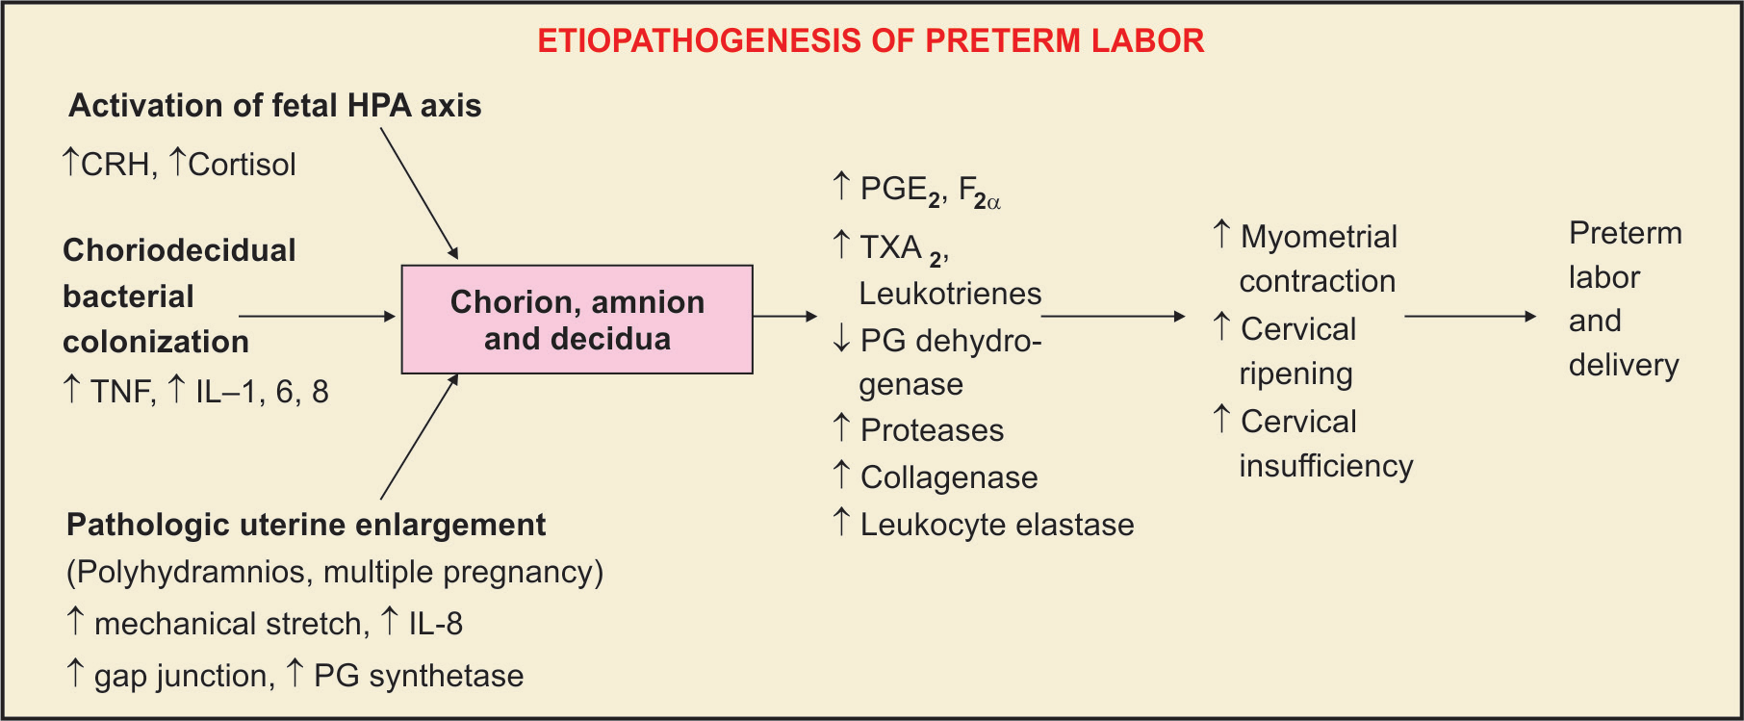

Slide 9
MANAGEMENT OF PRETERM LABOR
The management includes:
(1) To prevent preterm onset of labor, if possible
(2) To arrest preterm labor, if not contraindicated
(3) Appropriate management of labor
(4) Effective neonatal care.

Slide 10
Predictors of preterm labor:
A. Clinical predictors:
(i) History of prior preterm birth;
(ii) Multiple pregnancy;
(iii) Presence of genital tract infection
(iv) Symptoms of
B. Biophysical predictors:
(i) Uterine contractions (UC) > 4/hr
(ii) Bishop score > 4
(iii) Cervical length (TVS) < 25 mm.

Slide 11
C. Biochemical predictors:
(i) Fetal fibronectin (fFN) in cervicovaginal discharge.
Fibronectin is a glycoprotein that binds the fetal membranes to the decidua.
Normally it is found in the cervicovaginal discharge before 22 weeks and again after 37 weeks of pregnancy.
Presence of fibronectin in the cervicovaginal discharge between 24 weeks and 34 weeks is a predictor of preterm labor.
When the test is negative it reassures that delivery will not occur within next 7 days.

Slide 12
PREVENTION OF PRETERM LABOR
About 50%, the cause remains unknown.
Among the remaining complicated groups, decision has to be taken whether to allow the pregnancy to continue or not.
The risk of delivery of a low birth weight baby has to be weighed against the risks involved to the fetus and/or to the mother in continued pregnancy.

Slide 13
PREVENTION….
The following guidelines are adopted:
Primary care is aimed to reduce the incidence of preterm labor by reducing the high-risk factors (e.g. infection, etc.).
Secondary care includes screening tests for early detection and prophylactic treatment
Tertiary care is aimed to reduce the perinatal morbidity and mortality after the diagnosis (e.g. use of corticosteroids).

Slide 14
Investigations:
(1) Full blood count
(2) Urine for routine analysis, culture and sensitivity;
(3) Cervicovaginal swab for culture and fibronectin
(4) Ultrasonography for fetal well being, cervical
length and placental localization
(5) Serum electrolytes and glucose levels

Slide 15
Management of PTL
Management of PTL is aimed to reduce perinatal morbidity and mortality.
Th e principles of management are:
– To transfer the mother with the fetus in utero to a hospital where special care baby unit is available.
– To give glucocorticoid to the woman to reduce neonatal RDS (Resp Dist Synd).
– To start antibiotic to the woman if infection is present
– To start tocolytic medications to delay delivery at least for 48 hours.

Slide 16
DC Dutta’s Textbook of Obstetrics including Perinatology & Contraception Eighth Edition 2015 Edited by Hiralal Konar JAYPEE.

Slide 17
Thank you

